Slide 1
An Introduction to Sorting

Slide 2
Selection Sort – Method 1
Sorting: Arrange things into either ascending or descending order
Task: rearrange books on shelf by height
  The tallest books on the right
Approach:
  Look at books, select tallest book
  Swap with last book
  Look at remaining books, select tallest
  Swap with second last book
  Repeat …

Slide 3
OR

Slide 4
Selection Sort – Method 2
Sorting: Arrange things into either ascending or descending order
Task: rearrange books on shelf by height
  The smallest books on the right
Approach:
  Look at books, select smallest book
  Swap with first book
  Look at remaining books, select smallest
  Swap with second book
  Repeat …

Slide 5
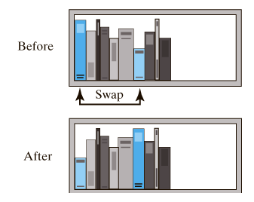
Selection Sort
Before and after exchanging shortest book and the first book.

Slide 6
Selection Sort – Method 1
5 | 1 | 3 | 4 | 6 | 2
Comparison
Data Movement
Sorted

Slide 7
Selection Sort
5 | 1 | 3 | 4 | 6 | 2
Comparison
Data Movement
Sorted

Slide 8
Selection Sort
5 | 1 | 3 | 4 | 6 | 2
Comparison
Data Movement
Sorted

Slide 9
Selection Sort
5 | 1 | 3 | 4 | 6 | 2
Comparison
Data Movement
Sorted

Slide 10
Selection Sort
5 | 1 | 3 | 4 | 6 | 2
Comparison
Data Movement
Sorted

Slide 11
Selection Sort
5 | 1 | 3 | 4 | 6 | 2
Comparison
Data Movement
Sorted

Slide 12
Selection Sort
5 | 1 | 3 | 4 | 6 | 2
Comparison
Data Movement
Sorted

Slide 13
Selection Sort
5 | 1 | 3 | 4 | 6 | 2
•
Largest
Comparison
Data Movement
Sorted

Slide 14
Selection Sort
5 | 1 | 3 | 4 | 2 | 6
Comparison
Data Movement
Sorted

Slide 15
Selection Sort
5 | 1 | 3 | 4 | 2 | 6
Comparison
Data Movement
Sorted

Slide 16
Selection Sort
5 | 1 | 3 | 4 | 2 | 6
Comparison
Data Movement
Sorted

Slide 17
Selection Sort
5 | 1 | 3 | 4 | 2 | 6
Comparison
Data Movement
Sorted

Slide 18
Selection Sort
5 | 1 | 3 | 4 | 2 | 6
Comparison
Data Movement
Sorted

Slide 19
Selection Sort
5 | 1 | 3 | 4 | 2 | 6
Comparison
Data Movement
Sorted

Slide 20
Selection Sort
5 | 1 | 3 | 4 | 2 | 6
Comparison
Data Movement
Sorted

Slide 21
Selection Sort
5 | 1 | 3 | 4 | 2 | 6
•
Largest
Comparison
Data Movement
Sorted

Slide 22
Selection Sort
2 | 1 | 3 | 4 | 5 | 6
Comparison
Data Movement
Sorted

Slide 23
Selection Sort
2 | 1 | 3 | 4 | 5 | 6
Comparison
Data Movement
Sorted

Slide 24
Selection Sort
2 | 1 | 3 | 4 | 5 | 6
Comparison
Data Movement
Sorted

Slide 25
Selection Sort
2 | 1 | 3 | 4 | 5 | 6
Comparison
Data Movement
Sorted

Slide 26
Selection Sort
2 | 1 | 3 | 4 | 5 | 6
Comparison
Data Movement
Sorted

Slide 27
Selection Sort
2 | 1 | 3 | 4 | 5 | 6
Comparison
Data Movement
Sorted

Slide 28
Selection Sort
2 | 1 | 3 | 4 | 5 | 6
•
Largest
Comparison
Data Movement
Sorted

Slide 29
Selection Sort
2 | 1 | 3 | 4 | 5 | 6
Comparison
Data Movement
Sorted

Slide 30
Selection Sort
2 | 1 | 3 | 4 | 5 | 6
Comparison
Data Movement
Sorted

Slide 31
Selection Sort
2 | 1 | 3 | 4 | 5 | 6
Comparison
Data Movement
Sorted

Slide 32
Selection Sort
2 | 1 | 3 | 4 | 5 | 6
Comparison
Data Movement
Sorted

Slide 33
Selection Sort
2 | 1 | 3 | 4 | 5 | 6
Comparison
Data Movement
Sorted

Slide 34
Selection Sort
2 | 1 | 3 | 4 | 5 | 6
•
Largest
Comparison
Data Movement
Sorted

Slide 35
Selection Sort
2 | 1 | 3 | 4 | 5 | 6
Comparison
Data Movement
Sorted

Slide 36
Selection Sort
2 | 1 | 3 | 4 | 5 | 6
Comparison
Data Movement
Sorted

Slide 37
Selection Sort
2 | 1 | 3 | 4 | 5 | 6
Comparison
Data Movement
Sorted

Slide 38
Selection Sort
2 | 1 | 3 | 4 | 5 | 6
Comparison
Data Movement
Sorted

Slide 39
Selection Sort
2 | 1 | 3 | 4 | 5 | 6
•
Largest
Comparison
Data Movement
Sorted

Slide 40
Selection Sort
1 | 2 | 3 | 4 | 5 | 6
Comparison
Data Movement
Sorted

Slide 41
Selection Sort
1 | 2 | 3 | 4 | 5 | 6
DONE!
Comparison
Data Movement
Sorted

Slide 42
Selection Sort – Method 2

Slide 43
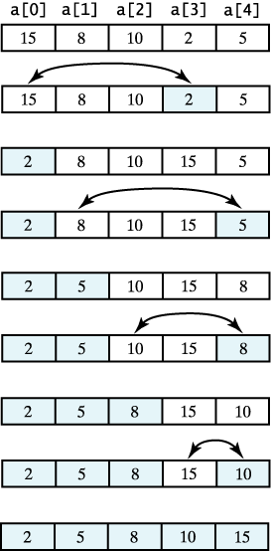
Selection Sort
A selection sort of an array of integers into ascending order.

Slide 44
Selection Sort
algorithm for selection sort
Algorithm selectionSort(a, n)
// Sorts the first n elements of an array a.
Step 1: Repeat steps 2,3,4 for index = 0,1,2,…,n − 1
Step 2: Set Min= a[ index] and LOC = index
Step 3: Repeat for J= index+1,index+2, . . . , n
search for the smallest element
if Min > a[J] then
Set Min := a[J] and LOC := J
end of loop
Step 4: Interchange the values of a[index] and a[LOC]
Set Temp := a[J], a[J] := a[LOC] and a[LOC] := Temp
Step 5: Exit.

Slide 45
The Efficiency of Selection Sort
Iterative method for loop executes n – 1 times
  For each of n – 1 calls, the Min is invoked, last is n-1, and first ranges from 0 to n-2.
  For each Min, compares last – first times
  Total operations: (n – 1) + (n – 2) + …+ 1 = n(n – 1)/2 = O(n²)
It does not depends on the nature of the data in the array.

